Slide 1

Session 2: Why learning languages is important
Lesson Objective:
To explore why it is important to learn a language
To discover why other people have chosen to learn another language

Slide 2
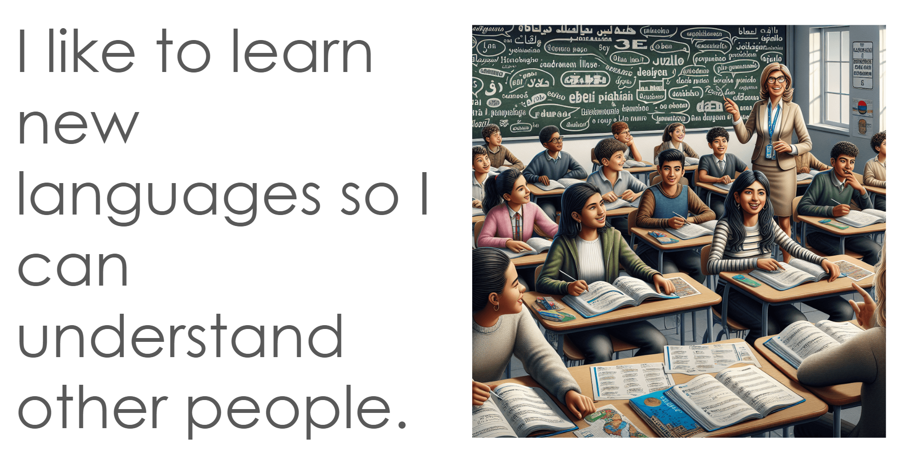
To explore why it is important to learn a language
To discover why other people have chosen to learn another language

Slide 3
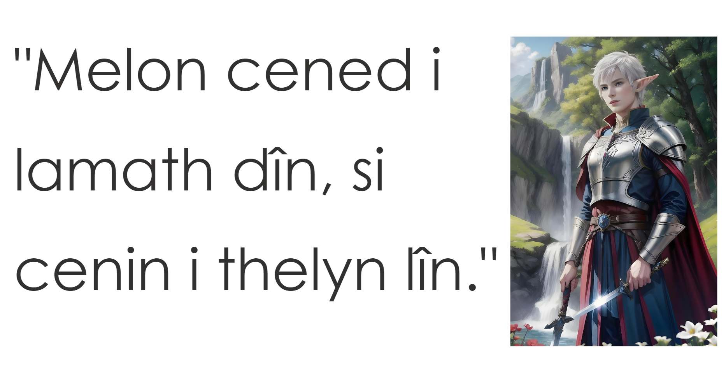
To explore why it is important to learn a language
To discover why other people have chosen to learn another language

Slide 4
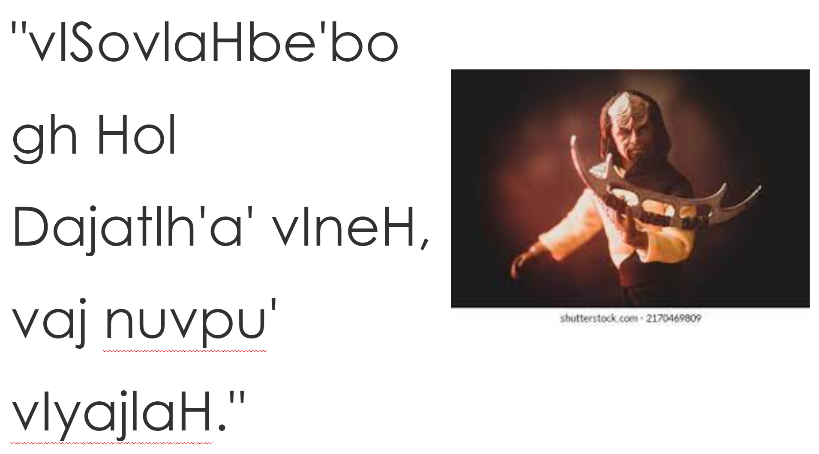
To explore why it is important to learn a language
To discover why other people have chosen to learn another language

Slide 5

To explore why it is important to learn a language
To discover why other people have chosen to learn another language

Slide 6
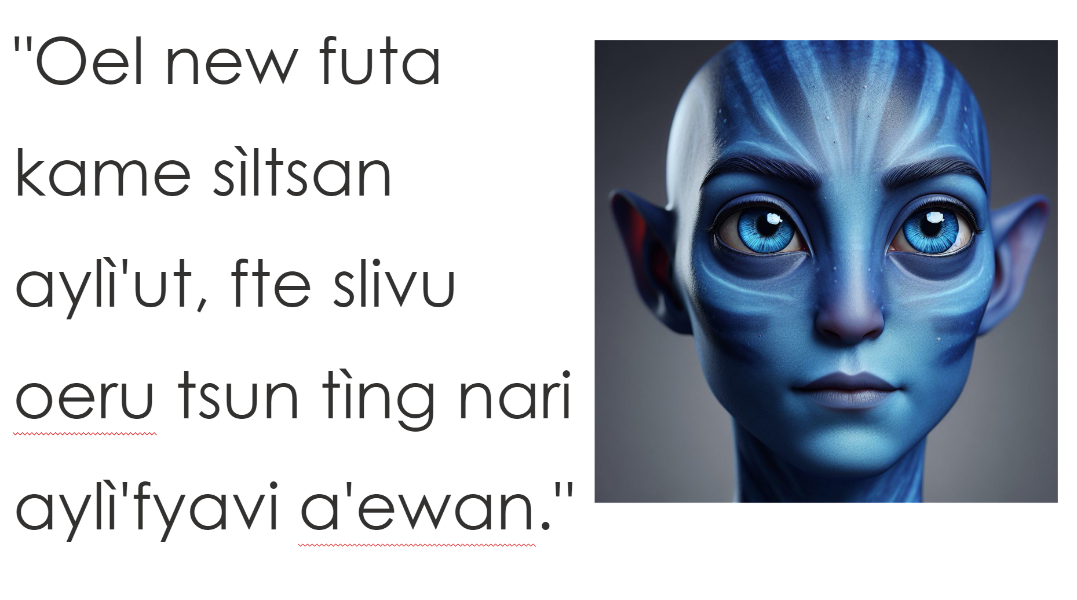
To explore why it is important to learn a language
To discover why other people have chosen to learn another language

Slide 7
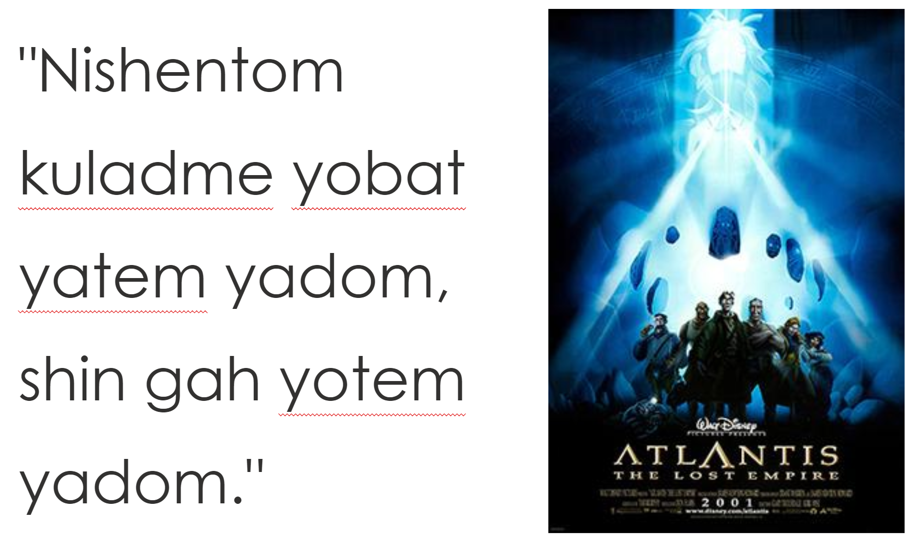
To explore why it is important to learn a language
To discover why other people have chosen to learn another language

Slide 8
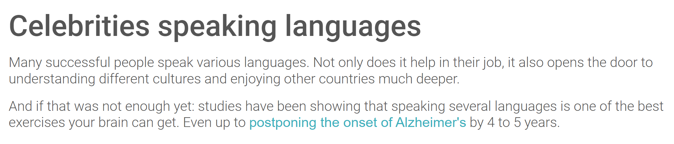
To explore why it is important to learn a language
To discover why other people have chosen to learn another language
https://edl.ecml.at/Facts/Celebritiesspeakinglanguages/tabid/3113/language/Default.aspx

Slide 9

To explore why it is important to learn a language
To discover why other people have chosen to learn another language
https://www.youtube.com/watch?v=HlRX0vYvi3I&t=37s

Slide 10

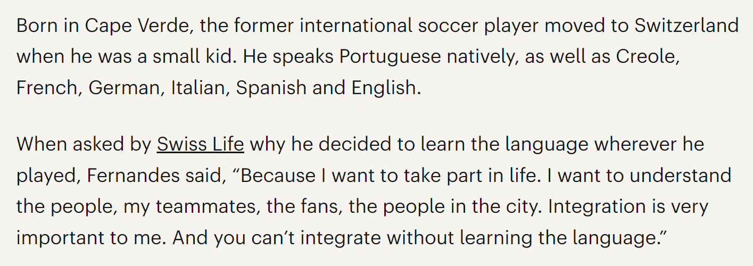
To explore why it is important to learn a language
To discover why other people have chosen to learn another language
https://www.youtube.com/watch?v=CyPMjcG9TqA&t=81s

Slide 11

To explore why it is important to learn a language
To discover why other people have chosen to learn another language
https://www.youtube.com/watch?v=d1t2DHIAFpc

