Slide 1

Session 4: Are you a language detective?
Lesson Objective:
To identify patterns in languages
To decode a new language using reading skills

Slide 2
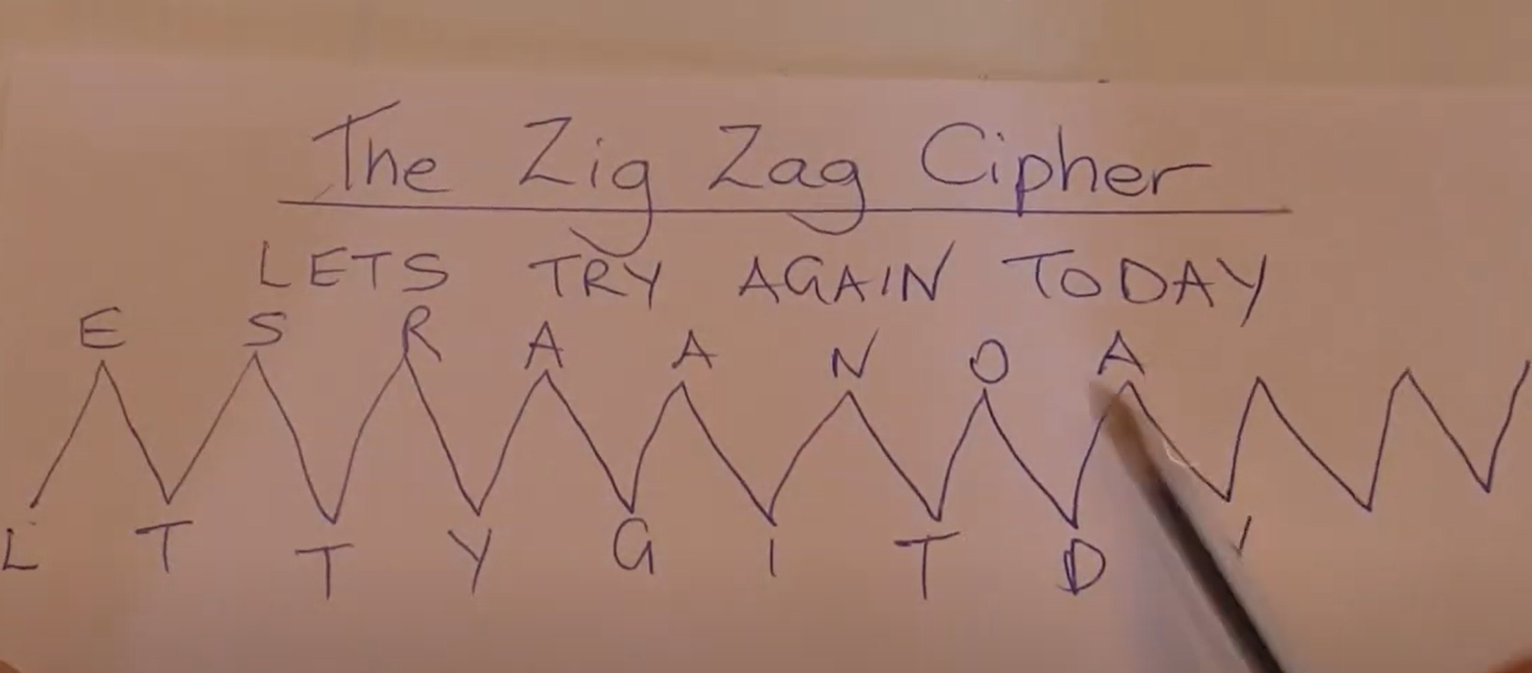


To identify patterns in languages
To decode a new language using reading skills
Can you crack the code?
https://www.youtube.com/watch?v=4JfyAb5lx24&t=110s

Slide 3
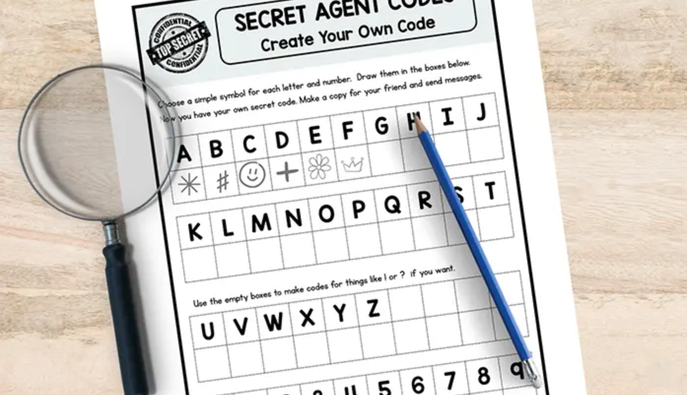

To identify patterns in languages
To decode a new language using reading skills
Lesson Objective
https://drive.google.com/file/d/1niv9e6jUDztAObv406oHpsnlvdXM9QE3/view

Slide 4
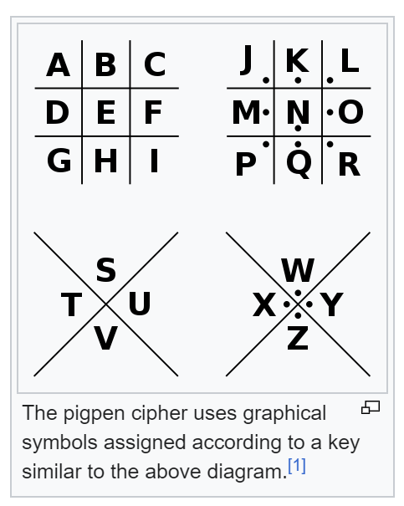


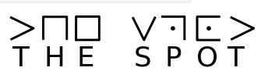
To identify patterns in languages
To decode a new language using reading skills
Lesson Objective
Pigpen Cipher

Slide 5
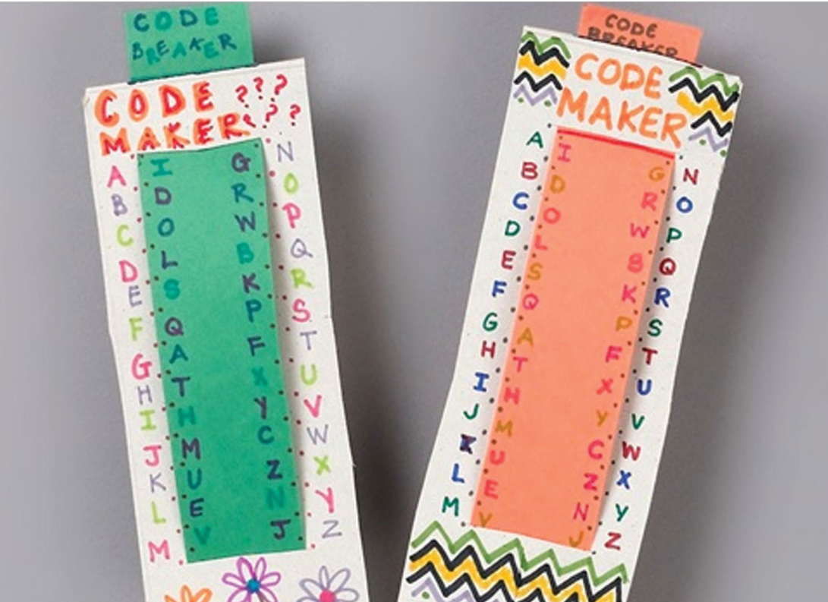
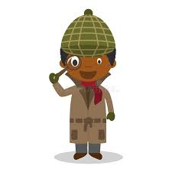
To identify patterns in languages
To decode a new language using reading skills
https://www.crayola.ca/crafts/code-maker--breaker-craft
https://www.youtube.com/watch?v=dVkUhArtT-w

Slide 6
To identify patterns in languages
To decode a new language using reading skills
I cnduo't bvleiee taht I culod aulaclty uesdtannrd waht I was rdnaieg. Unisg the icndeblire pweor of the hmuan mnid, aocdcrnig to rseecrah at Cmabrigde Uinervtisy, it dseno't mttaer in waht oderr the lterets in a wrod are, the olny irpoamtnt tihng is taht the frsit and lsat ltteer be in the rhgit pclae. The rset can be a taotl mses and you can sitll raed it whoutit a pboerlm. Tihs is bucseae the huamn mnid deos not raed ervey ltteer by istlef, but the wrod as a wlohe. Aaznmig, huh? Yaeh and I awlyas tghhuot slelinpg was ipmorantt! See if yuor fdreins can raed tihs too.

Slide 7

To identify patterns in languages
To decode a new language using reading skills
https://www.gonoodle.com/videos/92knjX/how-to-speak-pig-latin
https://bunnystudio.com/blog/a-quick-guide-for-translating-to-pig-latin-with-examples/

