Slide 1

Session 6:
A Country in a Box
Lesson Objective:
To recognise and produce information about a different country
g

Slide 2
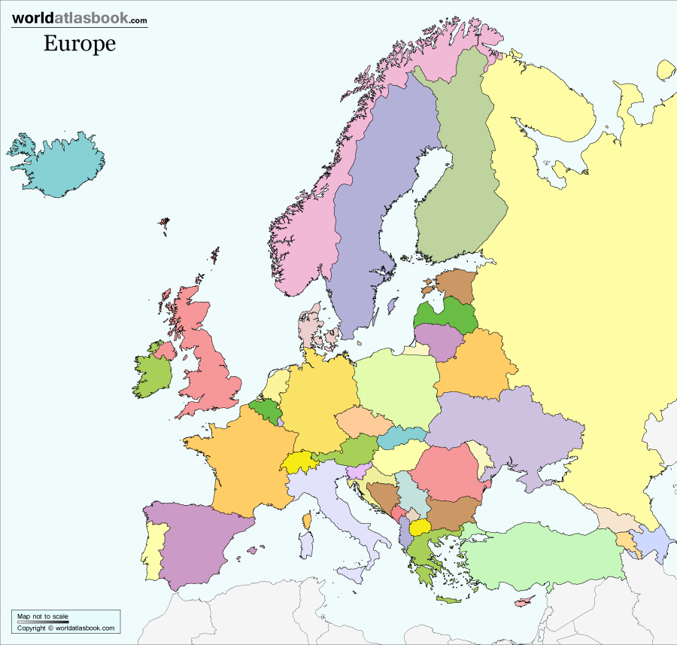
To recognise and produce information about a different country
Warm-up
There are 44 countries in Europe, how many can you name?
Notes:
Timer set for 1 minute

Slide 3
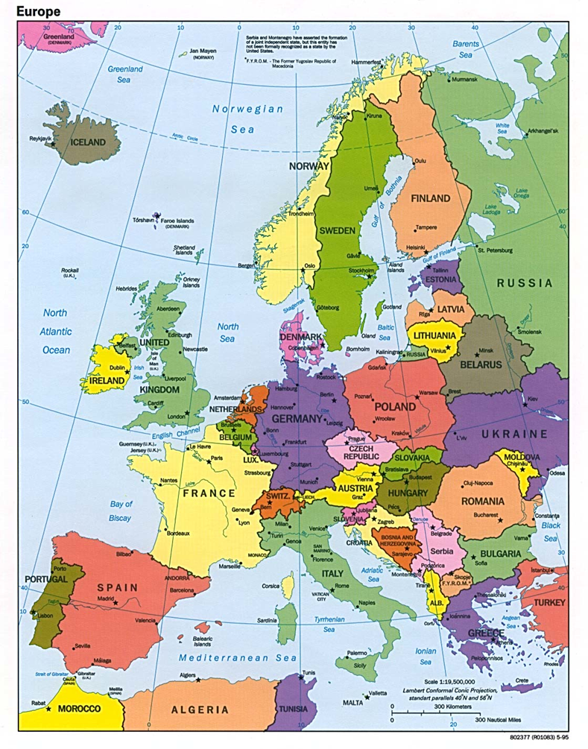
To recognise and produce information about a different country
Warm-up
There are 44 countries in Europe, how many can you name?
Notes:
Timer set for 1 minute

Slide 4
To recognise and produce information about a different country
Do you know which languages are spoken in each country?
Notes:
Teachers may select different countries

Slide 5
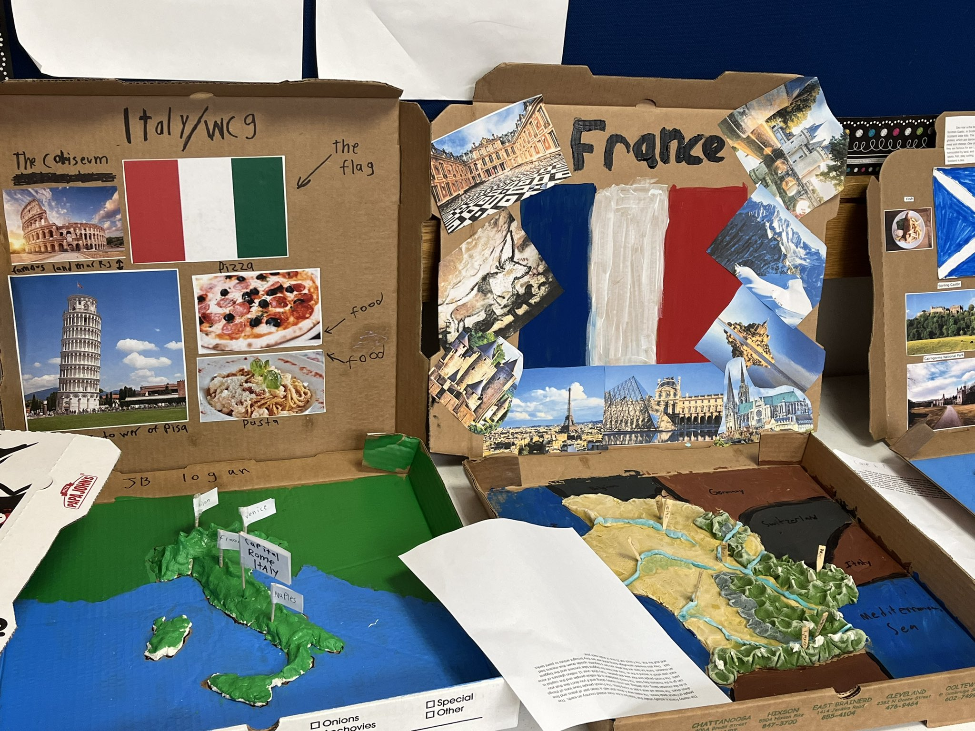
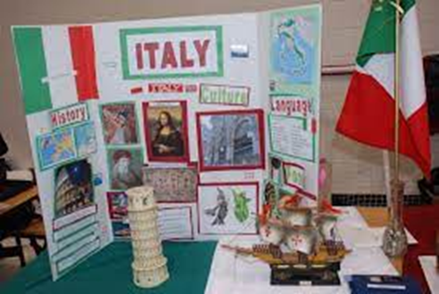
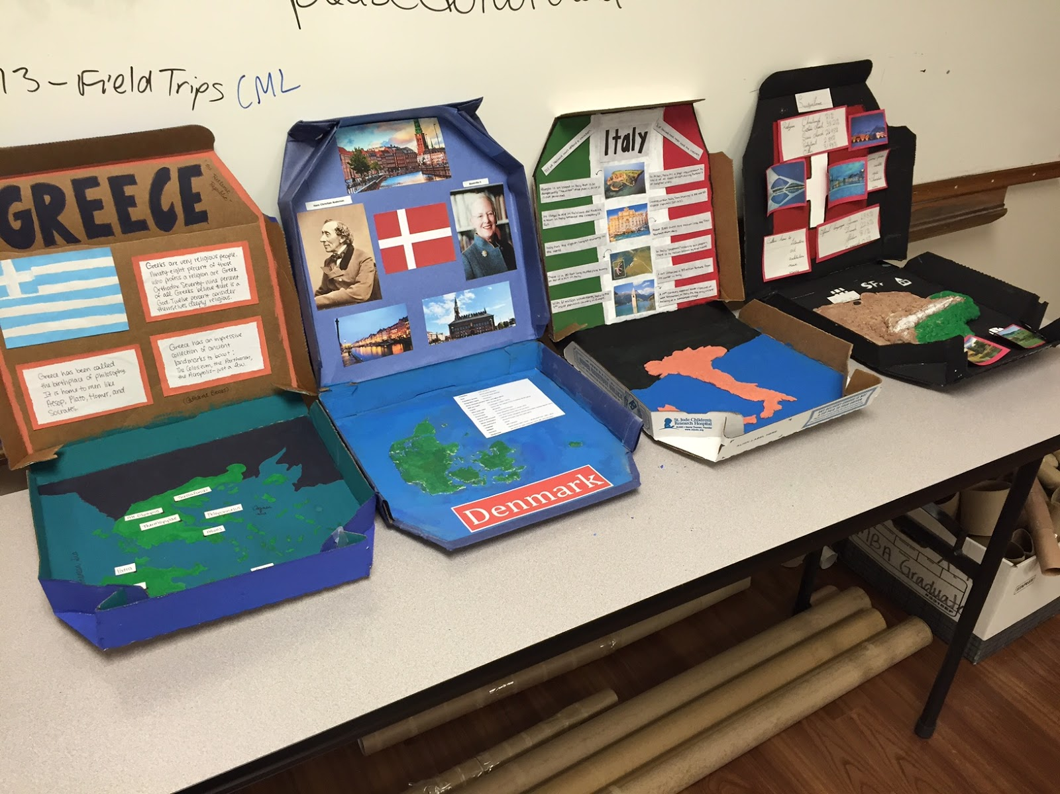
To recognise and produce information about a different country
A Country in a Box
Task:
To produce a box that reflects and informs others about your chosen country. How creative can you be?
Notes:
Teachers may select different countries or pupils may prefer to select their home language (if appropriate)
Teachers may decide the groups (recommended 2-3)

Slide 6
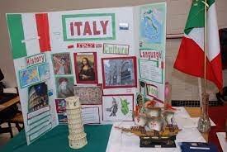
To recognise and produce information about a different country
You may wish to research and include information about:
the language or languages spoken
population
key facts about the country
cuisine
traditions
traditional clothing
music
sport
history
Notes:
Ideas of things to include in their box

Slide 7

To recognise and produce information about a different country
A Country in a Box
Presentation time!
Notes:
Students may wish to present at the front of the class or you may wish to showcase the work on tables and have students circulate the room while filling in an information sheet.

Slide 8
To recognise and produce information about a different country
A Country in a Box
Country | Fact One | Fact Two | Fact Three
Notes:
Students circulate the classroom and complete the table using the information presented in boxes.

Slide 9
To recognise and produce information about a different country
3-2-1
3 countries you have discovered in today’s lesson
2 new facts you have learned about different countries
1 place you would be interested visiting and why
Notes:
Teachers may select different countries

