Slide 1
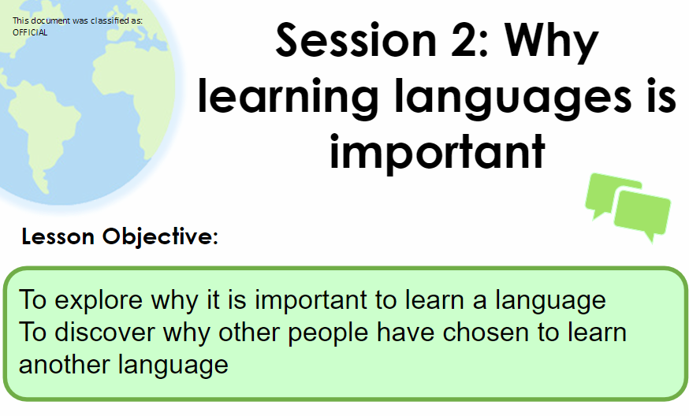

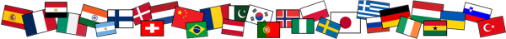
Name:
Class:
Why is speaking the same language important?

Slide 2
Who / What / Why?
Who?
What?
Why?
Colin Firth
Actor
Married to an Italian
“If you talk to a man in a language he understands, that goes to his head. If you talk to him in his own language, that goes to his heart.” Nelson Mandela

Slide 3
If you talk to someone in a language they understand, that goes to their head. If you talk to them in their own language, that goes to their heart. Nelson Mandela

